Slide 1


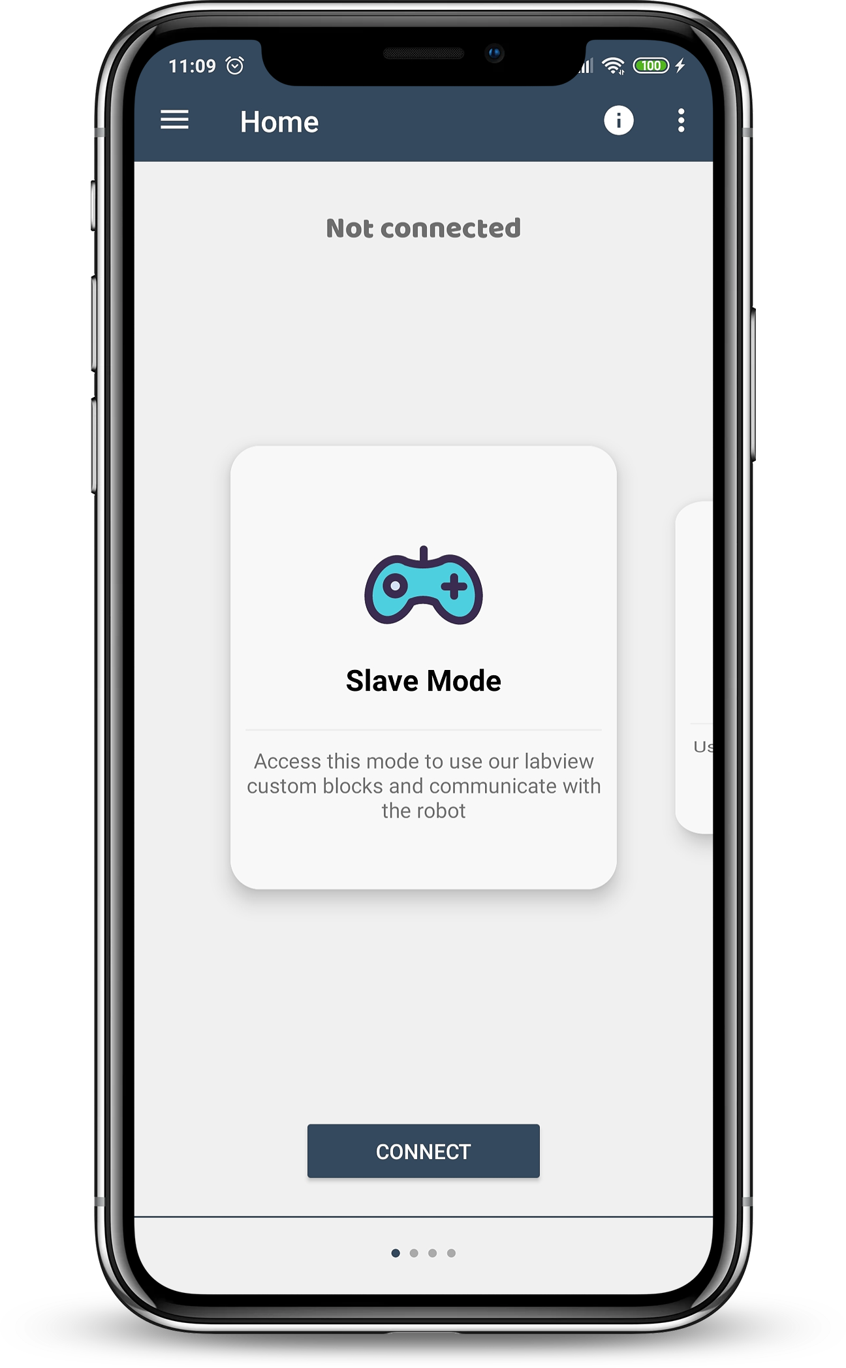


Presenting data on the phone by robophone
Uploading the date to firebase
Measuring soil moisture, temperature and humidity in the garden

Slide 2
Features
Measuring soil moisture in the plant by capacitive soil moisture sensor 1.2.
Measuring temperature in the garden by .
Writing to firebase the measurements, both soil moisture and temperature.
Presenting soil moisture/date graph on the app.
The user will determine which “variables” will receive real-time updates or notifications.(לשים לב שהוא יכול לשנות את הדבר הזה אחר כך, אולי להסיר משתנה או להוסיף עוד אחד...)
Display graphs for the variables based on the user's selection.

Slide 3
